Slide 1


Material Analysis: Insulation
Jean Kim, Advanced Polymeric Materials Branch Intern
Witold Fuchs, Ph.D Advanced Polymeric Materials Branch, M&P Technical Lead
Notes:
“Thermal Decomposition analysis of AEPS soft goods”

Slide 2
Bottom-line up front (BLUF)
Objective: Identify the material composition of insulation material
Instruments: FTIR, LIBS
Conclusion: The material is most likely silicon oxide fiberglass.

Slide 3
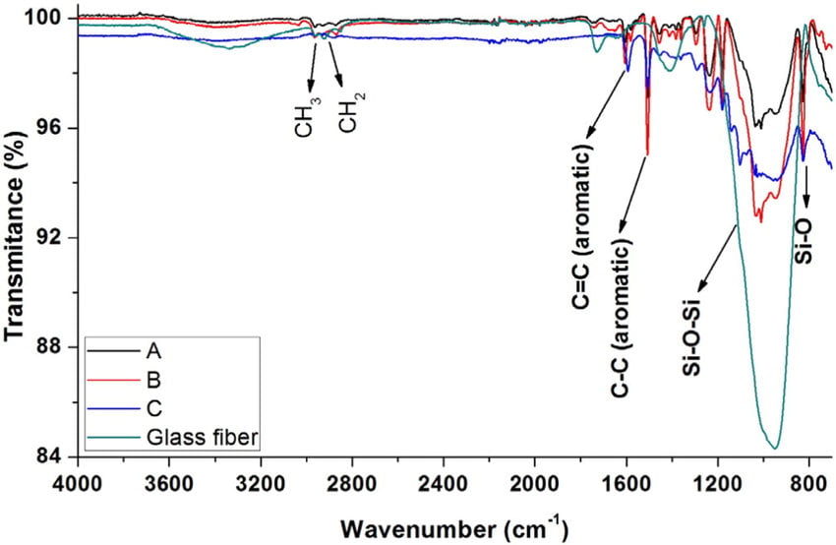
Fourier Transform Infrared spectroscopy (FTIR) Analysis
Comparing to known spectra of fiberglass: The associated peak at around ~1050 cm-1 indicates Si-O-Si bond
Bonon, Anderson & Weck, Marcus & Bonfante, Estevam & Coelho, Paulo. (2016). Physicochemical characterization of three fiber-reinforced epoxide-based composites for dental applications.
Notes:
FTIR Functional Group Database Table with Search – InstaNANO

Slide 4
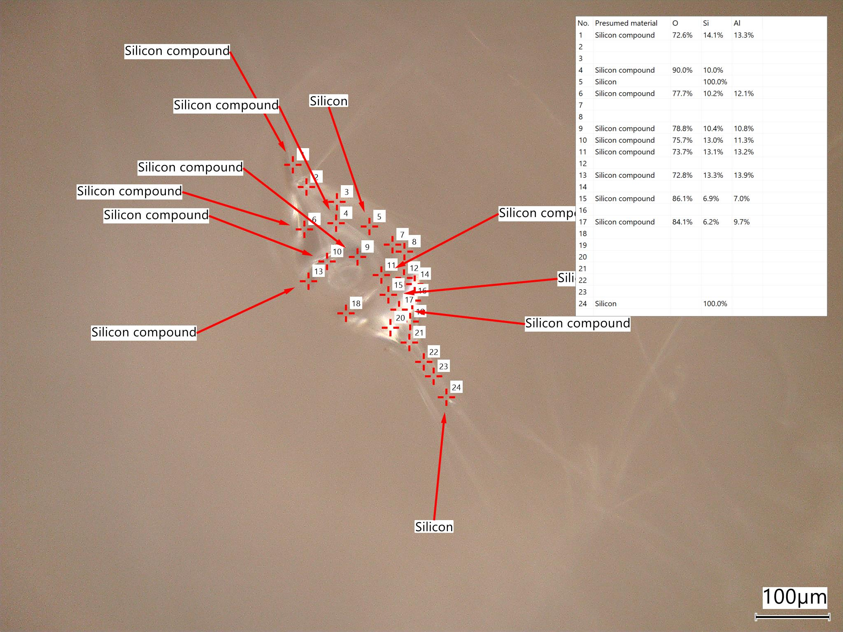
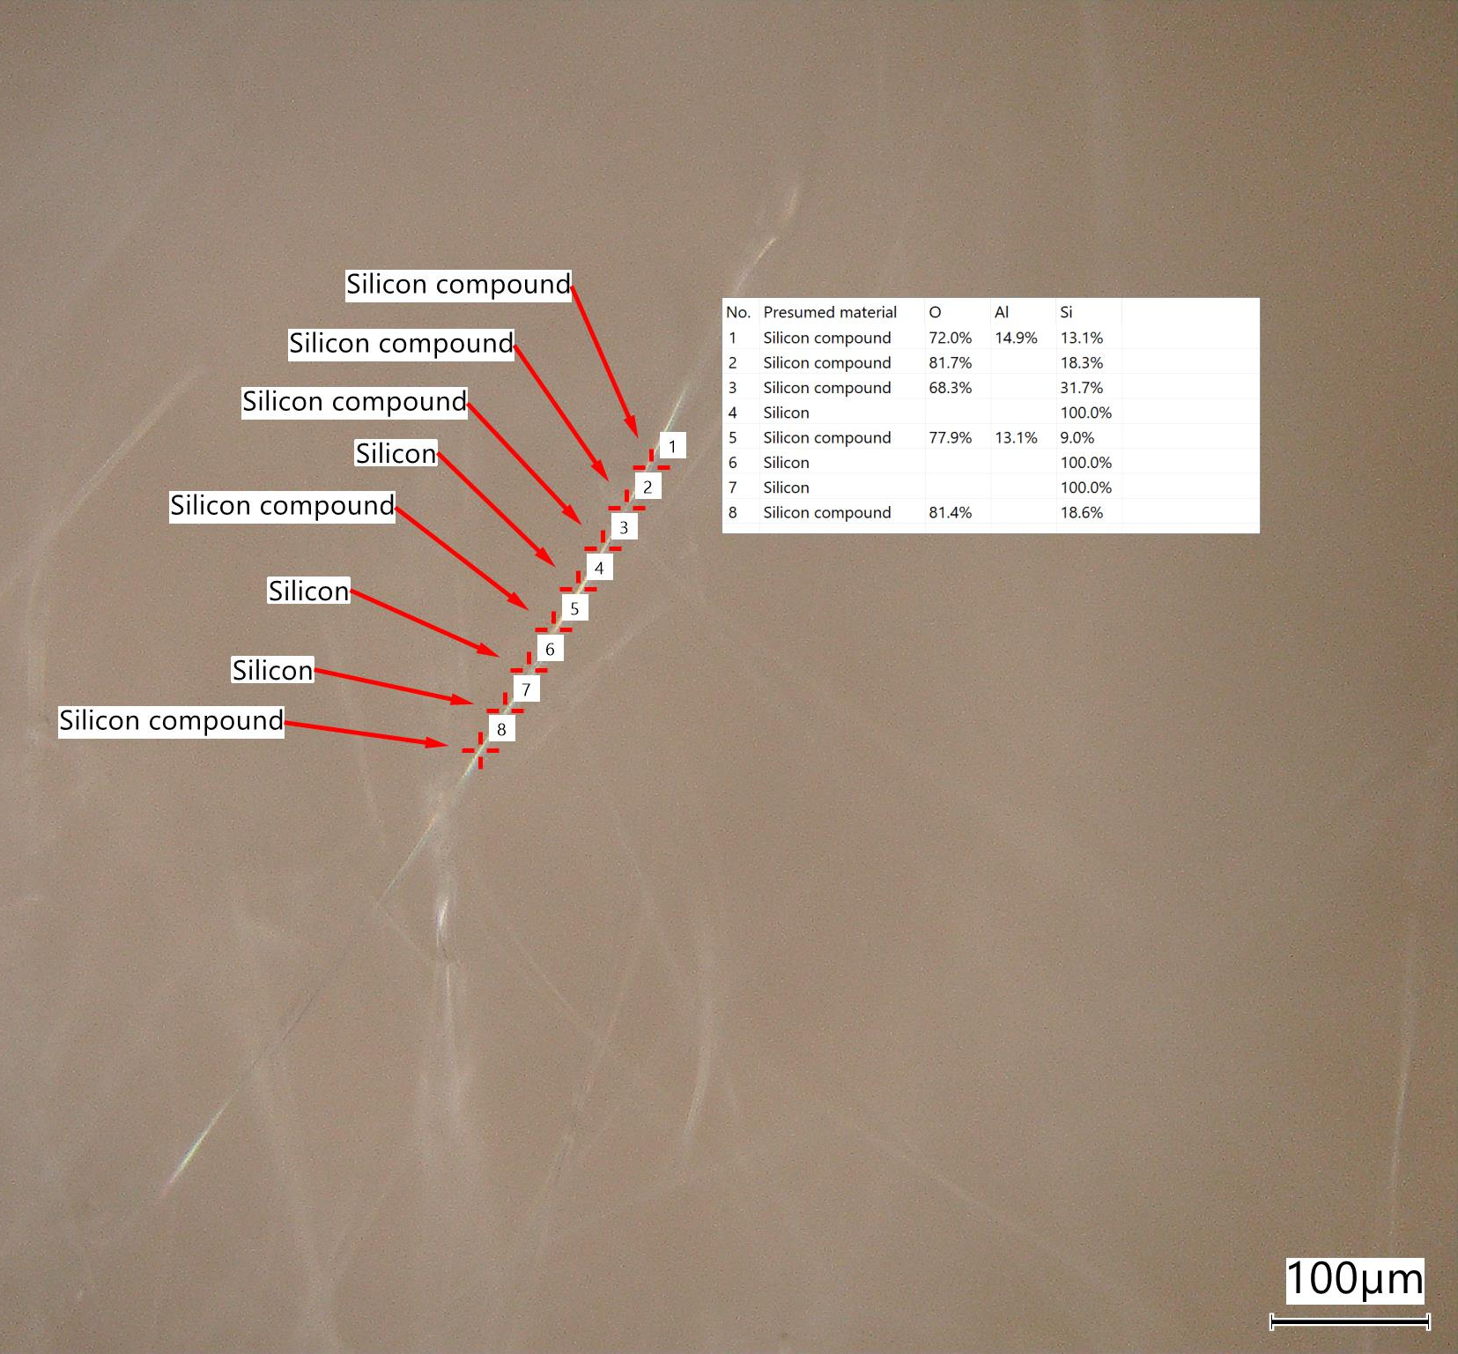
Laser Induced Breakdown Spectroscopy (LIBS) Analysis
Results show:
Possibly aluminosilicate
Fiberglass with possibly aluminum oxide in the batch
Confirms that this material is inorganic
High temperature fibrous material

Slide 5
Summary
FTIR result show that the material is inorganic with silicate network of Si-O-Si.
LIBS results confirm the material is inorganic and possibly being aluminosilicate, due to the aluminum content along with Silicon and Oxygen
  These materials are high temperature and fibrous.
The material is most likely silicon oxide fiberglass.

